Slide 1
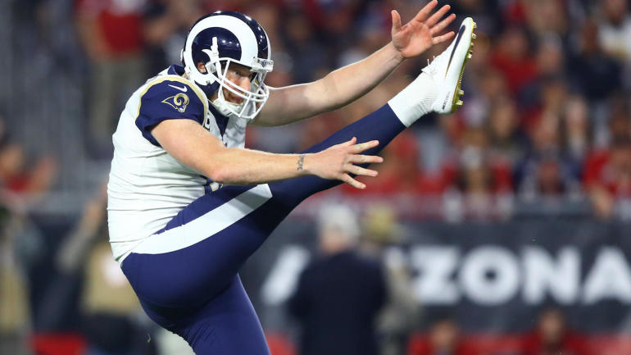
IST687
NFL Punting and Concussions
Jon Kaplan and Jeff Bertucci

Slide 2
Dataset Info
666 games observed from 2016-2017 NFL seasons
6,681 punt plays analyzed
146,529 observations of player roles during punt plays
66,492, 490 observations of players locations and orientation during punt return play

Slide 3
Data Questions
What are the most common impact types resulting in concussions during punt plays?
Is the distance from punter to punt returner a factor in more concussions?
Does time in the game or Quarter play a factor in more concussions?
Does certain weather or certain temperature range increase or decrease occurrences of concussions?
Do more concussions happen on synthetic turf or natural? Outdoor or indoor stadium?
Does game start/time of day play a factor in more concussions? Day of week?
The more a team punts, the more concussions?
What is the relationship of speed and direction for likelier occurrence of concussion?

Slide 4
Descriptive Info
 | Count
Helmet-to-body | 17
Helmet-to-ground | 2
Helmet-to-helmet | 17
Unclear | 1
37 concussions from 2016-2017 NFL seasons :
12 preseason, 25 regular season games
Average temperature for concussion-involving games: 60.73° F

Slide 5
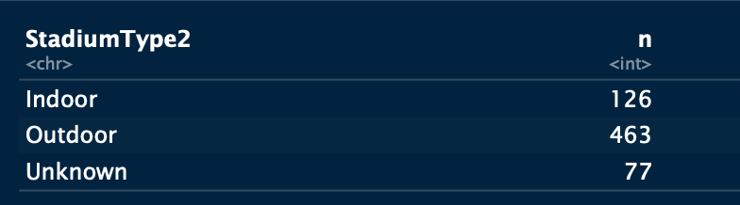
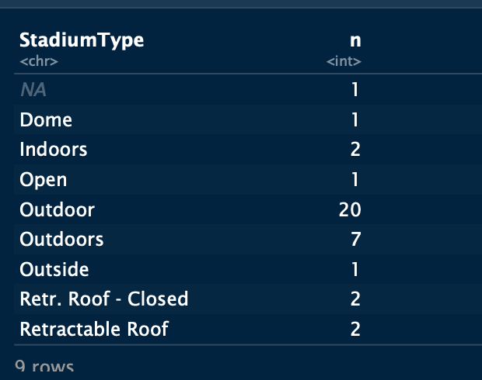
Stadium
All 666 games:
Concussion Games:

Slide 6
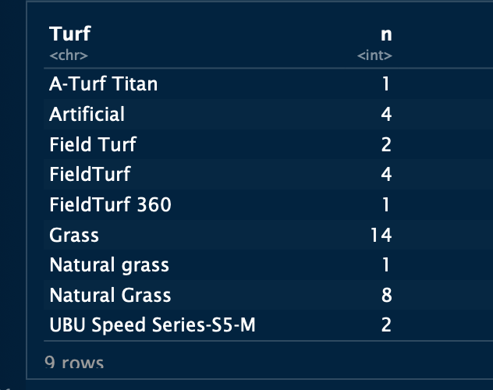
Turf
23 concussions occured on natural grass
13 concussions occured on synthetic grass

Slide 7
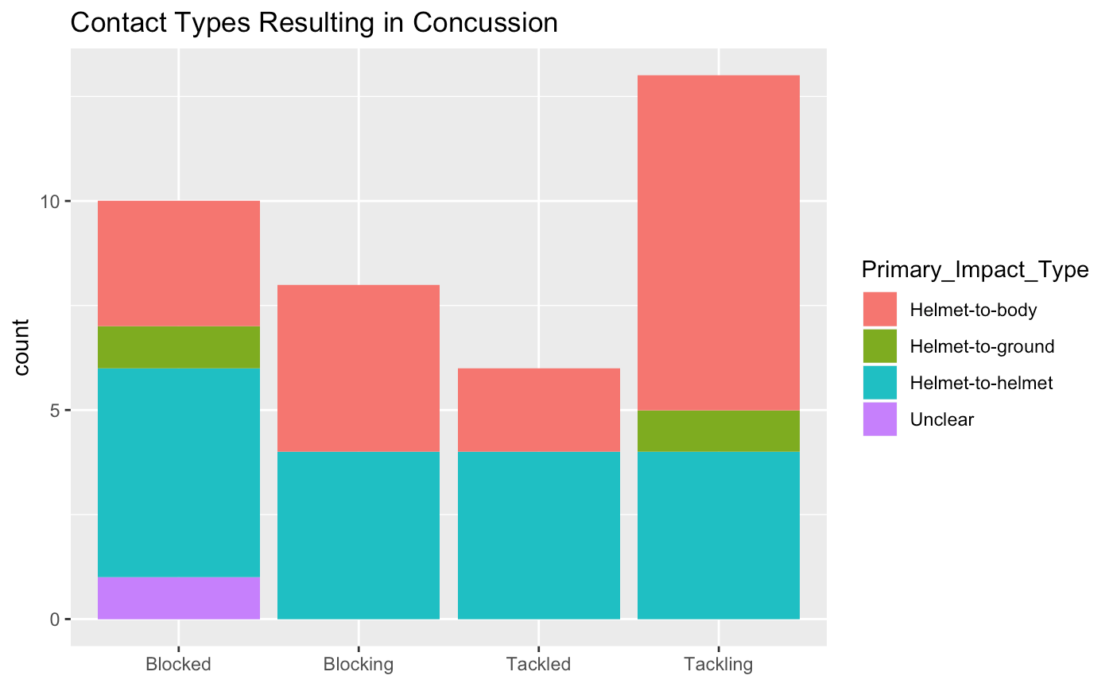
Types of Plays for Impacts
Quotations are commonly printed as a means of inspiration and to invoke philosophical thoughts from the reader.

Slide 8
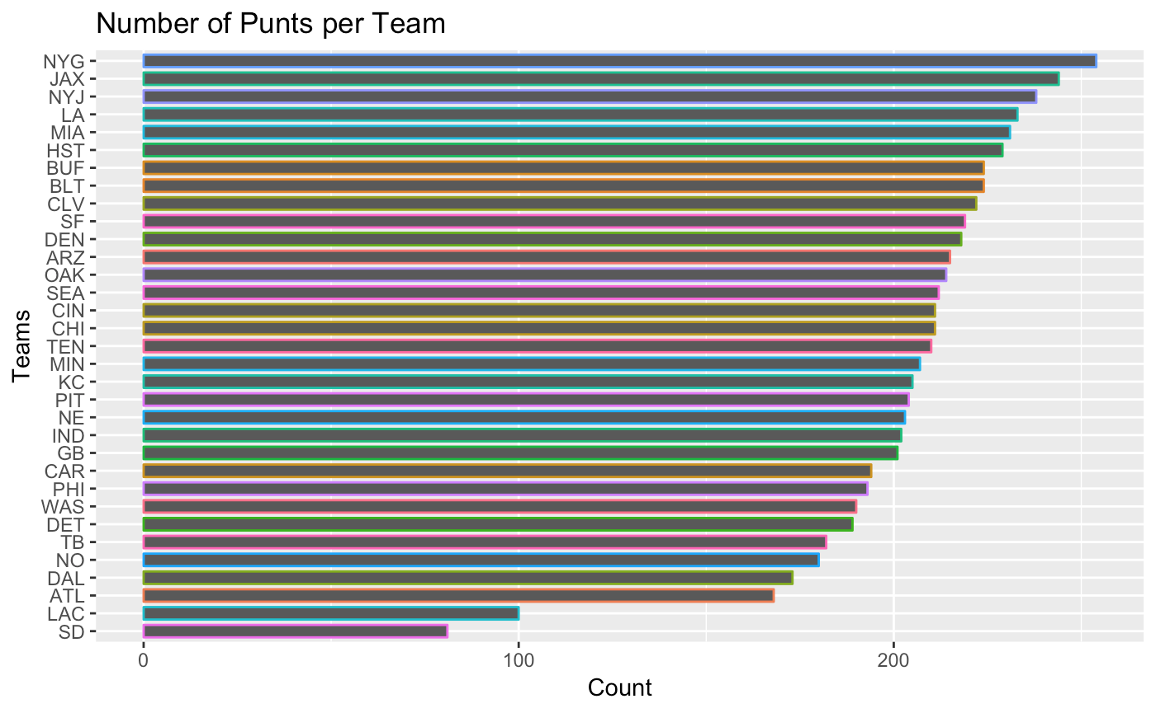
Number of Punts per Team
Quotations are commonly printed as a means of inspiration and to invoke philosophical thoughts from the reader.
Chance of concussion on punt play: 0.55% (37/6681)

Slide 9
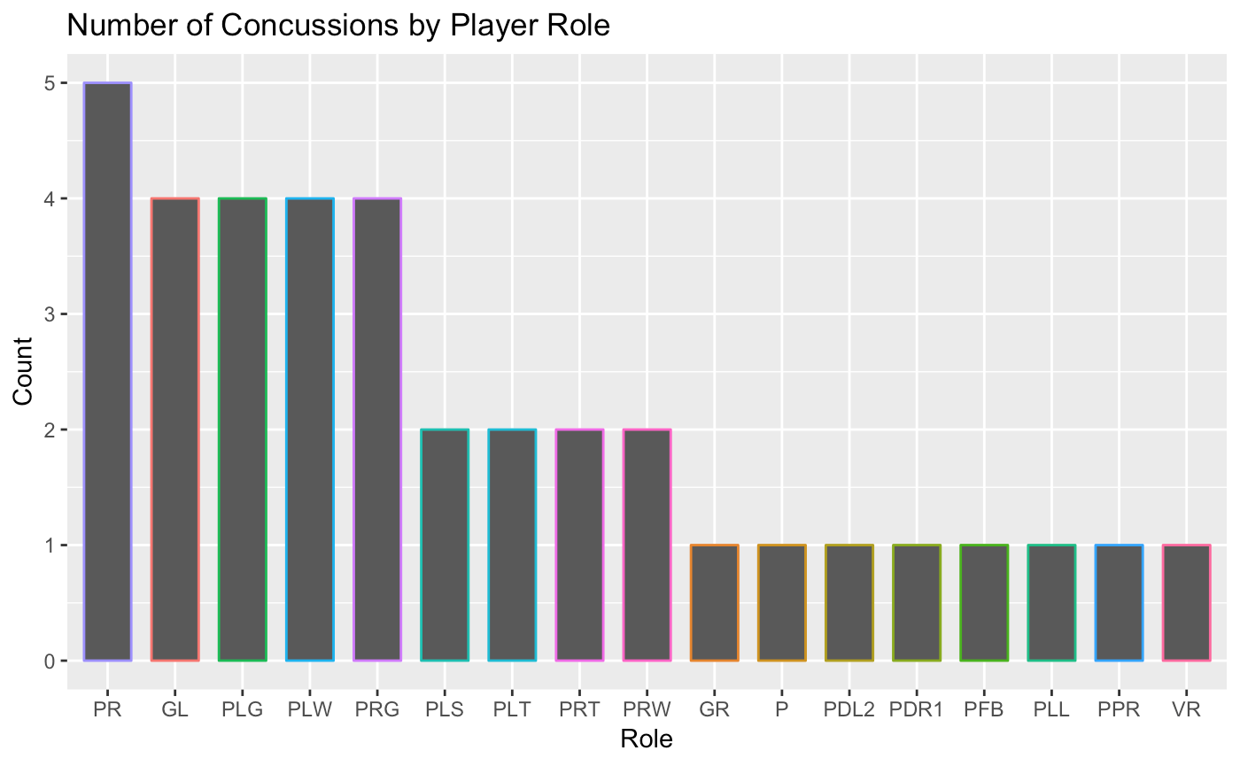
Player Roles
Quotations are commonly printed as a means of inspiration and to invoke philosophical thoughts from the reader.

Slide 10
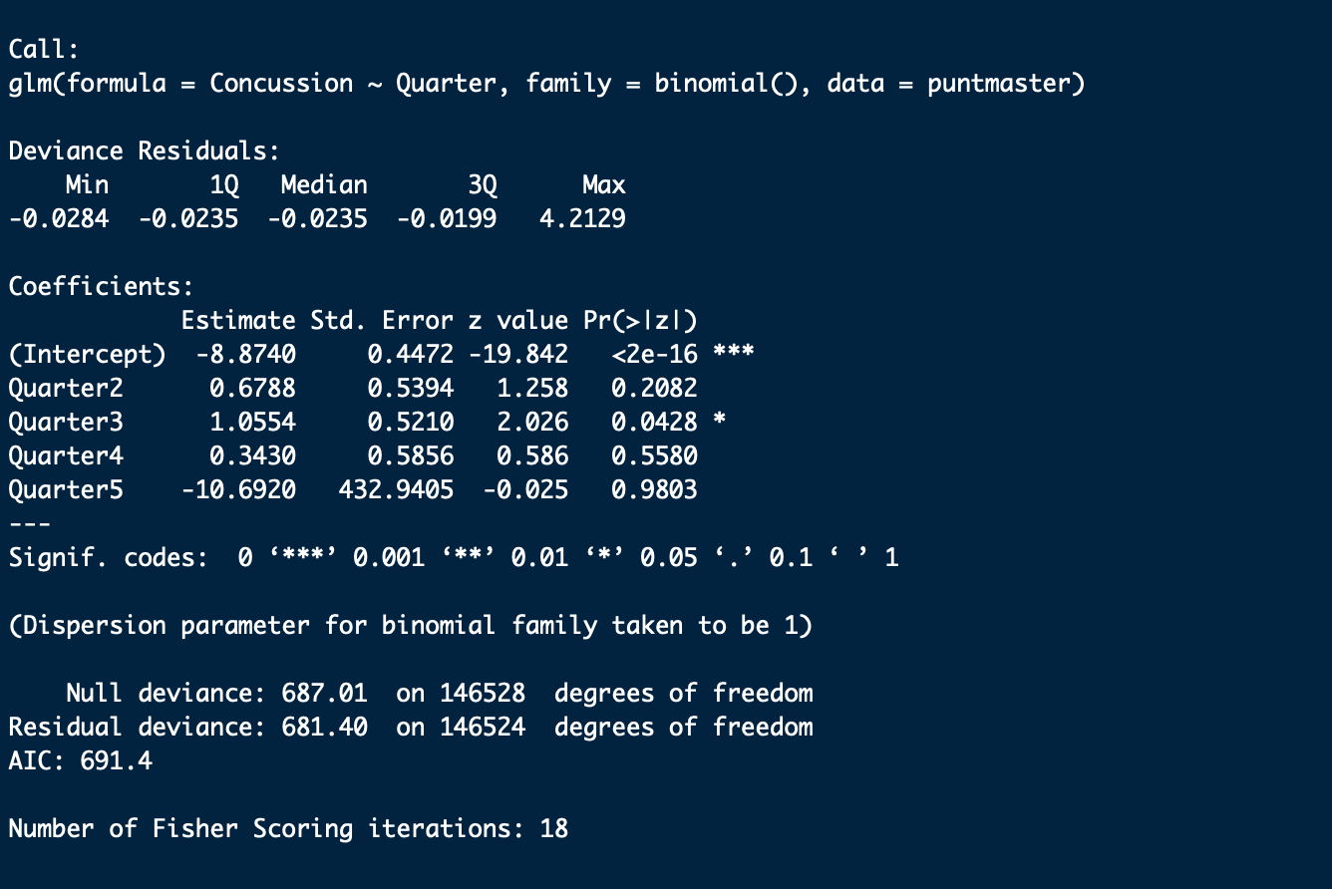
Regression
Ran regressions on few columns in relation to # of concussions: Game_Day, Turf, Temperature, and Quarter
For model 5, our Quarter regression, Quarter 3 turned out to be significant with a value of 0.0428

Slide 11
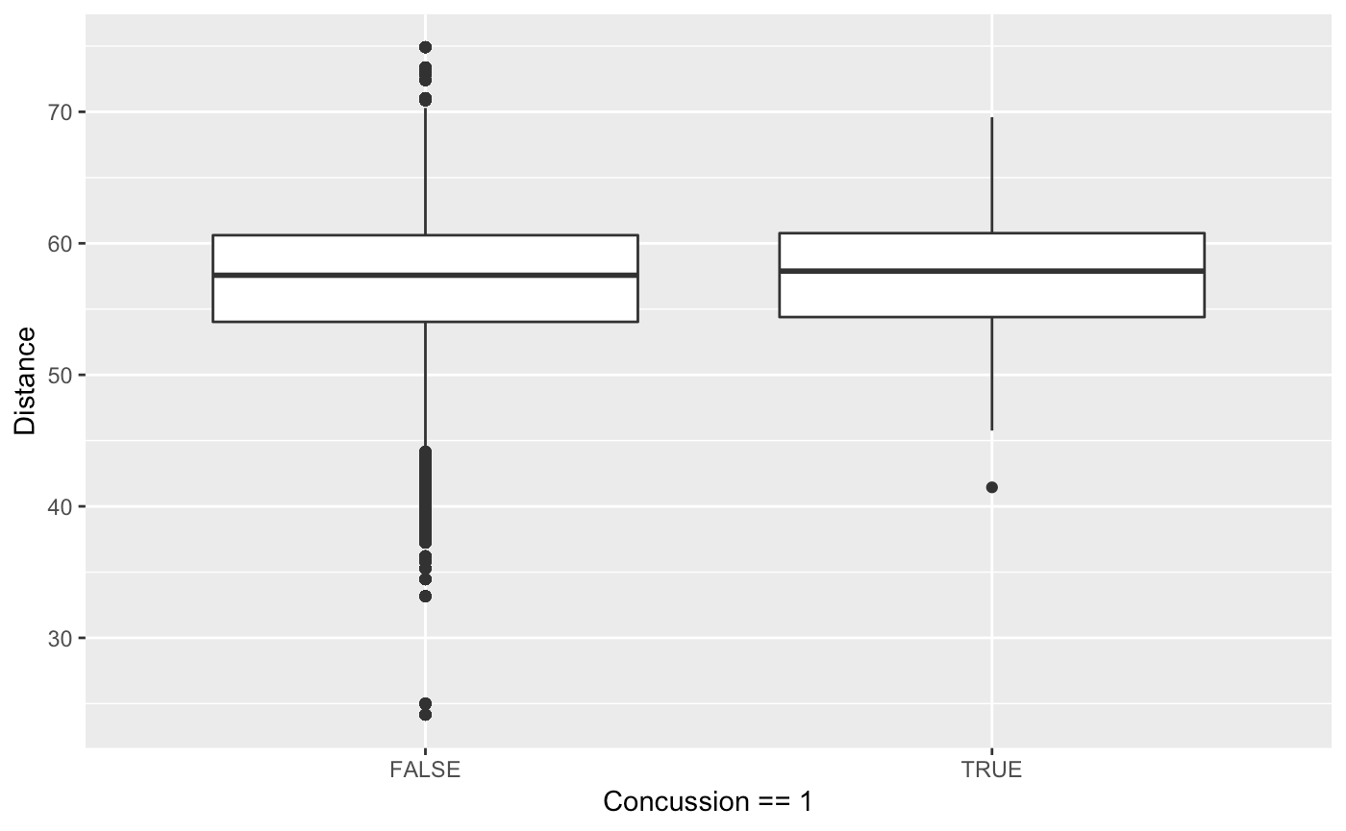
Distance between P and PR
Looked at distance between Punter and Punt Returner on punt plays at time of punt to see if relationship for concussions
Average distance: 57.51 yards
Concussion average distance: 56.62 yards
Range (non-conc): 24.16 - 74.92 yards
Range (conc): 41.45 - 69.59 yards

Slide 12
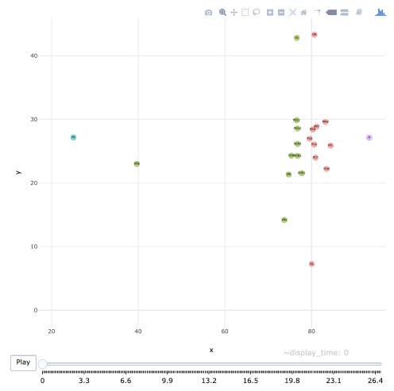
Animated Concussion Plot
Created animated plot to show specific concussion play based off PlayID
Gives birds-eye view of positions and players involved

Slide 13
Machine Learning-RandomForest
We ran a random forest analysis of all the punt plays from 2016-2017.
“Unfortunately” there were only 36 concussions in both years combined
Of those, we could only assume 6 were derivative of the punt play
Those would be concussions involving the punter or the punting reciever

Slide 14
Machine Learning-RandomForest 2
Nonetheless, we ran a random forest to see if we could glean ANYTHING
We take into consideration: Turf, Weather, Quarter, Season Week, and the score differentials
Results: As expected, not stellar, but it did score a 99.99% on its test
 | Predicted 0 | Predicted 1
Actual 0 | 13278 | 0
Actual 1 | 6 | 0

Slide 15
Importance
Season_Type 0.02738847
Week 1.00023094
Game_Day 0.45209800
GameWeather 0.03522921
Temperature 1.61750888
StadiumType2 0.09042840
Quarter 0.72063474
Role 0.64749300
Score_difference 1.94196796
NaturalTurf 0.21137473
Call:
randomForest(formula = Concussion ~ ., data = puntmaster4)
Type of random forest: classification
Number of trees: 500
No. of variables tried at each split: 3
OOB estimate of error rate: 0.05%
Confusion matrix:
0 1 class.error
0 13278 0 0
1 6 0 1

Slide 16
Improving our RandomForest
More data, specifically more actual concussion data.
If we were to run again maybe consider concussion per game rather than per play
That may be more interesting since we are considering global effects more so than exact moment to moment effects.

Slide 17
Machine Learning-KSVM
Sparing most of the similar details of RF
KSVM was surprisingly worse.
The goal: rout out the 1’s in the concussion category
The result: KSVM Model guessed the opposite of Random forest and got 0.001% correct, but it definitely did get all the 1’s

Slide 18
> ML2
Support Vector Machine object of class "ksvm"
SV type: C-svc (classification)
parameter : cost C = 5
Polynomial kernel function.
Hyperparameters : degree = 1 scale = 1 offset = 1
Number of Support Vectors : 8
Objective Function Value : -40
Training error : 0.000452
Cross validation error : 0.000452
Probability model included.
> summary(as.factor(comptable$prediction))
1
4428

Slide 19
Lesson Learned:
Computers do exactly what you tell them to do

Slide 20
Resources
Animated Plot
http://jimkloet.com/animated_nfl_play.html
https://www.kaggle.com/c/NFL-Punt-Analytics-Competition

